Slide 1
Crop marks
Purpose & usage of printing marks

Slide 2





Agenda
Introduction
Most Common Used Marks
  2.1 Sample Page with Marks
Crop Marks
3.1 When We Use the Crop Marks
Bleeding
PrintNet T & Marks
Summary

Slide 3

1 Introduction

Slide 4

1 Introduction
Page could be marked with marks
Marks indicate:
    - page margins
    - correct set up
    - color registration, etc.
Indication for:
    - operator of the machines (printer, cutter, folding unit)
Usually outside format of the page
Notes:
Pages for printing (mainly for high volume printing) are equipped with printing marks. Used variety of marks depends on printed document, on used SW or on a printer.
In particular cases do not have to be used any printing mark (e.g. when A4 text document is to be printed on A4 paper, 1 page on each sheet, standard borders, black & white)
Indication = main purpose of printing marks.
They indicate:
where document on the page has the margins
whether setup of printing in printing SW is correct
whether printer is set-up correctly
whether colors are set-up and printed correctly
Where to fold pages after printing
They indicate for
operator of the machine (printer, cutter, folding machine) – visual check
Print marks are usually outside the document => they will be cut out, so they won’t be visible on the final document. Some marks are inside the page e.g. fold marks or stitch marks.

Slide 5
2 Most Common Used Marks

Slide 6

2 Most Common Used Marks
Crop Marks
Correct set-up of cutting
Lines placed at the corners of the page
Registration Marks
Correct color registration
Crosses at the centers of the edges
Notes:
Crop marks:
Also known as Cut marks or Trim Marks
Registration Marks:
Registration in this context means correct print of colors from the position point of view (e.g. when we want to print a green line we put blue and yellow colors together. If the registration is correct we will get the green line printed, if the registration is incorrect we will get printed shifted two lines - one yellow and the another one blue)
When the color registration is correct the mark (mostly a cross) is black otherwise there should be shifted color crosses.
Appearance: A cross is the most common appearance
Position: Position should be different in practice (usually it is optional, so user could choose the position of marks)

Slide 7
2 Most Common Used Marks
Center Marks
Correct folding of the page
Lines at the place where the page will be
folded
Color Marks
Correct colors check
Color squares on the page edges
Notes:
Center Marks:
Sometimes remain on the page after whole processing. Indicate place where the page will be folded. Lines are not across the whole document, but usually short thin lines at the upper edge and the bottom edge of the page.
Color Marks:
They are used to check visually how the basic colors (cyan, magenta, yellow and black) or spot colors are printed (e.g. whether the gold color is as gold as we want it to be)

Slide 8
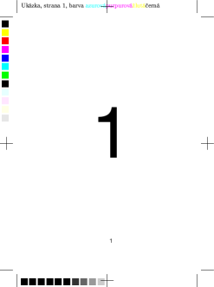
2.1 Sample Page with Marks
Additional Marks
Color Marks
Registration Mark
Crop Marks
Notes:
Center Marks:
No center marks are on this sample page. If this page should be folded (e.g. two page spread) center marks will be instead of the registration marks on the vertical or horizontal sides of the page (depends on the required orientation of the spread)
Additional Marks:
Theoretically you can put there any information you need (on this sample page there is on the top of the page: job name, page number and used colors – written in Czech language)

Slide 9
2 Crop Marks

Slide 10

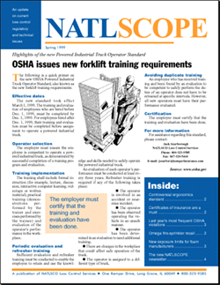
3 Crop Marks - Purpose
  Purpose = Indication
  Where to trim the paper around:
  - document
  - artwork
  - single object on a page
  For bleeding pages = only indication where the page should end
Notes:
Several sets of cut marks can be placed on a page => one page can be cut from one printing sheet or two or more, or only one object can be cut from a page (e.g. picture)
Bleeds = where the artwork goes past the edge of the paper.
Printer is not able to print to the very edge of page => bleeding
We use bleeding when we want to print e.g.:
Image over the whole page
Artwork, text, small image, or any other object to the very edge of the page (over one or two or three edges of the page)
Sample images on the right side:
Upper image = full bleeding – whole page is bleeding (image in background)
Bottom image = only blue squares are bleeding

Slide 11
3 Crop Marks - Appearance
Appearance
  Thin solid black lines
  Not strictly standardized
  Each SW could have “own format“
Margins
  added to page so crop marks are not “outside” the document
Notes:
Appearance:
Not strictly standardized means – thickness, length, shape could be slightly different => each SW should have “own” format
Margins:
Example: When you have A4 page/document and you want to add crop marks to cut it as A4 then the crop marks will be placed outside the document, therefore you have to add margins to place crop marks there.

Slide 12
3 Crop Marks - Exceptions
  Exceptions
  Some SW’s do not print crop marks if:
    the page size = paper size
    they fall outside printing area of the printer
SW Support
  Not each SW includes/offers it
  Plug-ins or special printing SW
Notes:
Exceptions: Not important topic, just an example of printing SW logic.
SW:
When your SW does not offer printing marks insertion you can update it by plug-in or use special SW for printing which inserts cut marks into your pages.

Slide 13
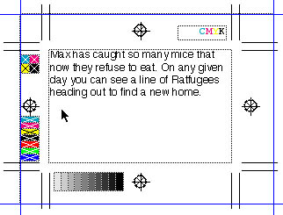
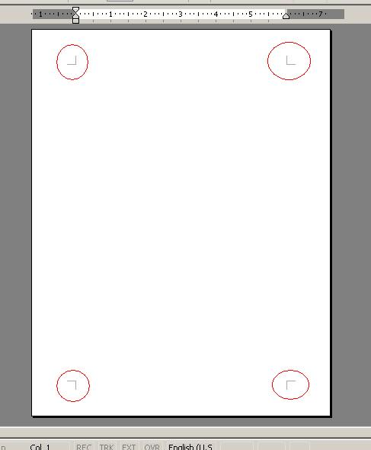
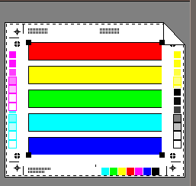
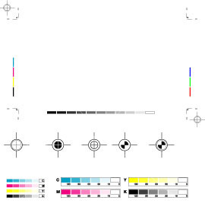
3 Crop Marks – Different look
Examples from several SW products:
Notes:
Nothing to explain on this page, just note different appearance and placement of the printing marks.

Slide 14
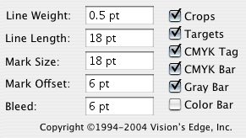
3 Crop Marks – Setup Example
Example of setup for marks in SW:
Selection of marks user wants to appear
SW allows to adjust their sizes and offsets
Selection of the object or objects to be surrounded by crops
Crop marks are automatically placed on the page
Notes:
SW for this example = Crops XT (screenshot is from version for MAC)

Slide 15
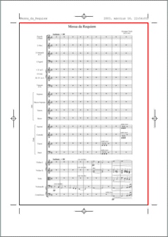
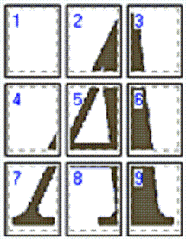
3.1 When We Use the Crop Marks
Cutting
  Basic purpose
  Page will be cut according the marks
  Page smaller than paper size
Printing over a number of pages
  Cut marks help to cut and join pages
  Used together with overlaps
Notes:
Cutting:
Comment to the picture: Red rectangle represents document page area, this will be cut out from paper. (The red area is specified by crop marks, the gray rectangle represents paper)
Note: red rectangle is not on the page, its only for this example to highlight the area.
Printing over a number of pages:
Overlap = part of document (e.g. picture) repeated on more than one page (bottom edge of page 1 is repeated also on page 4 as a top margin)
Comment to the picture: Dashed lines define crop areas.

Slide 16
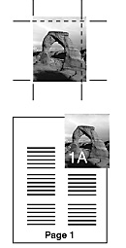
3.1 When We Use the Crop Marks
Bleeding
  Artwork (e.g. color, picture, texture) to the very edge of page
  Used also for thin frames
  Print on larger paper and trim
  Critical is precision of the cutting blades
Notes:
When artwork is going to be printed to the very edge of the paper it has to “bleed” over a crop area.
See upper picture - we want to print right and upper side to the very edge, so it has to bleed over area determined by crop marks.
Bottom picture shows practical application of the picture in the document (note picture bleeds over border of “Page 1”)
This slide shows just basic overview, next chapter is dedicated to bleeding.

Slide 17
4 Bleeding

Slide 18
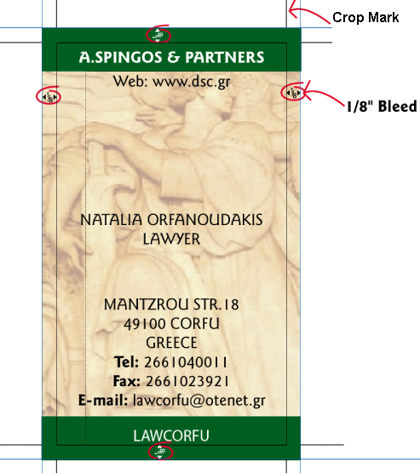
4 Bleeding - reason
Trim Tolerance
  High volume cutters are imprecise
  Trim tolerance of 1/32" to 1/16" = normal and acceptable
Color bleeding
  1/8" bleed extending beyond the crop marks to accommodate trim tolerance
  Otherwise a white edge can appear on the final job
Notes:
Trim tolerance is the reason why bleeding has to be used– we have to print over coped area so there will not appear white space on the edges caused by possible shift of cutting blades.
Cutters’ imprecision is caused by thickness of the cutting blades (They have to be very thick to penetrate large quantities of paper)
As you can see on the picture, crop marks are necessary for bleeding – it is the only indication where document (artwork, picture) has the border
When whole artwork bleeds the page it is called “edge to edge” printing.
Measures: 1/32” = 0.8mm
1/16” = 1.6mm
1/8” = 3.1mm

Slide 19
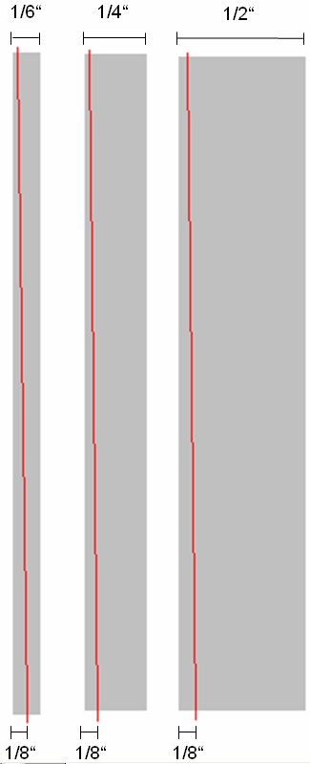
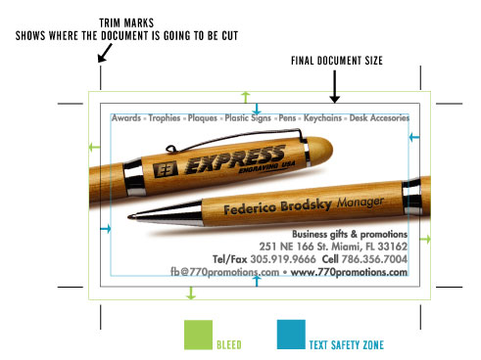
4 Bleeding - Borders
Thin borders
  For a thin border or frame within the final cropping area is recommend width at least 1/4“
Safe area
  Area inside the crops where text should not appear
Notes:
Thin Borders:
If the width is less then ¼”, border or frame can appear asymmetrical after cropping (because of trim tolerance).
See picture:
- Red line shows line of cutting. The Part of the frame, left from the red line, will be cut out.
- 1/6” frame: The part of the frame, right from red-line, seems to be asymmetrical, the bolder frame is the less asymmetrical the not-cut part of the frame seems to be.
Safe Area:
Picture shows bleeding of two objects (pens) on a business card.
There is also “safe area” shown. Text should not be too close to the trim area or else it could happen some parts of text will be cut out due to imprecision of the cutting blades.

Slide 20
5 PrintNet T & Marks

Slide 21
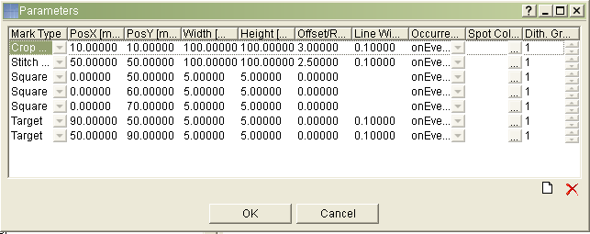

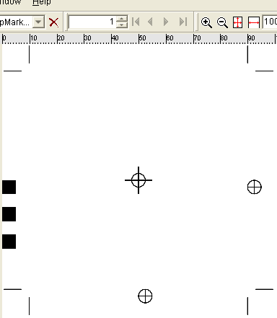
5 PrintNet T & Marks
Crop marks
Stitch mark
Target
Squares
Notes:
In PNetT marks are available by module “Marks Inserter”.
When a user double clicks the module, the shown dialogue appears and the user can select required marks and set-up their parameters. All available settings are shown on the screenshot of the dialogue.
Variety of marks available in PNetT is shown in red ellipse (Crop Mark, Stitch Mark, Square Mark, Target)
Marks Inserter has to be placed in workflow AFTER a Layout module and BEFORE an Output Module (Output module is required! Else proof is not possible)
On the bottom picture, sample page is shown with marks created in PNetT (according to the set-up from dialogue above).
Crop marks at the corners, three squares (each should be filled by a spot color), targets (in this example used as “center marks”), stitch mark in the middle of the page.

Slide 22
6 Summary

Slide 23
6 Summary
Main purpose = indication
Variable appearance
Optional support in SW products
Required for bleeding
Supported by PrintNet T
Notes:
Main purpose of the marks is indication for the operators of the machines. Crop marks indicate where the page will be cut.
Appearance of the marks is not strictly standardized, also not every SW which offers printing offers marks insertion. We can use plug-ins or special SW.
Bleeding is most common application where crop marks are used. Crop marks are necessary for bleeding! We have to use bleeding since cutters are imprecise.
Print Net T supports insertion of the printing marks (Of course! ☺)

Slide 24

Thank You.
Notes:
Q/A

